Slide 1
Machine Learning Algorithms
K-MEANS CLUSTERING
AHMED YOUSRY

Slide 2
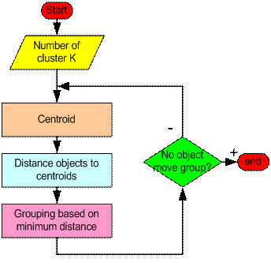
How the K-Mean Clustering algorithm works?

Slide 3
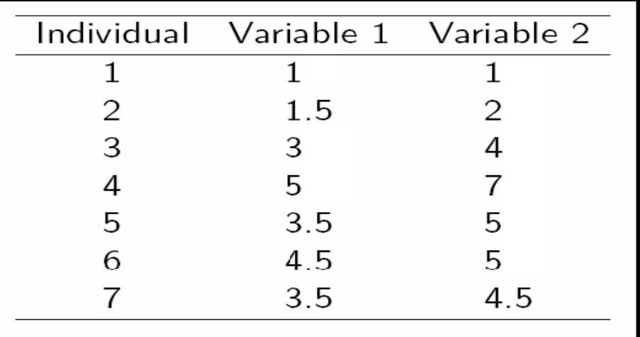
A Simple example k-means (using K=2)

Slide 4



K= 2
6
5
4
3
2
1
0
 |  |  |  |  | 6 |  | 4
 |  |  |  | 7
 |  |  | 3 | 5 | C2
 |  | 2
1 | C1
Variable 1
0
1
2
3
4
Variable 2
5
6
7
8
2

Slide 5
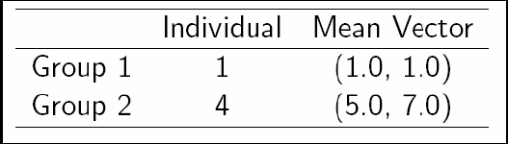
Step 1:
Initialization: Randomly we choose following two centroids (k=2) for two clusters. In this case the 2 centroid are: m1=(1.0,1.0) and m2=(5.0,7.0).

Slide 6
Step 2:
 | Centroid 1 |  |  |  |  |  |  | Centroid 2
1 | √( 1 | – 1 | )² | + | ( 1 – 1 | )² | = 0 | √( 5 | – 1 | )² | + | ( 7 | – 1 | )² | = 7.21
2 | √( 1 | – 1.5 | )² | + | ( 1 – 2 | )² | = 1.12 | √( 5 | – 1.5 | )² | + | ( 7 | – 2 | )² | = 6.10
3 | √( 1 | – 3 | )² | + | ( 1 – 4 | )² | = 3.61 | √( 5 | – 3 | )² | + | ( 7 | – 4 | )² | = 3.61
4 | √( 1 | – 5 | )² | + | ( 1 – 7 | )² | = 7.21 | √( 5 | – 5 | )² | + | ( 7 | – 7 | )² | = 0
5 | √( 1 | – 3.5 | )² | + | ( 1 – 5 | )² | = 4.72 | √( 5 | – 3.5 | )² | + | ( 7 | – 5 | )² | = 2.5
6 | √( 1 | – 4.5 | )² | + | ( 1 – 5 | )² | = 5.31 | √( 5 | – 4.5 | )² | + | ( 7 | – 5 | )² | = 2.06
7 | √( 1 | – 3.5 | )² | + | ( 1 – 4.5 | )² | = 4.30 | √( 5 | – 3.5 | )² | + | ( 7 | – 4.5 | )² | = 2.92

Slide 7
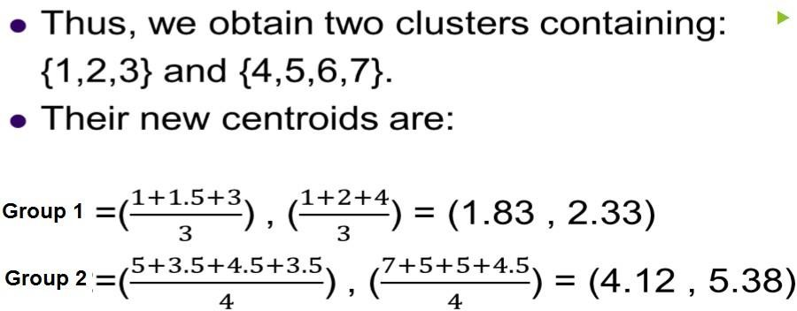
Step 2:

Slide 8
Step 3:
 | Centroid 1 |  |  |  |  |  |  |  | Centroid 2
1 | √( 1.83 | – 1 | )² | + | ( 2.33 | – 1 | )² | = 1.57 | √( 4.12 | – 1 | )² | + ( | 5.38 | – 1 | )² | = 5.38
2 | √(1.83 | – 1.5 | )² | + | (2.33 | – 2 | )² | = 0.47 | √( 4.12 | – 1.5 | )² | + ( | 5.38 | – 2 | )² | = 4.29
3 | √(1.83 | – 3 | )² | + | (2.33 | – 4 | )² | = 2.04 | √( 4.12 | – 3 | )² | + ( | 5.38 | – 4 | )² | = 1.78
4 | √(1.83 | – 5 | )² | + | (2.33 | – 7 | )² | = 5.64 | √( 4.12 | – 5 | )² | + ( | 5.38 | – 7 | )² | = 1.84
5 | √(1.83 | – 3.5 | )² | + | (2.33 | – 5 | )² | = 3.15 | √( 4.12 | – 3.5 | )² | + ( | 5.38 | – 5 | )² | = 0.73
6 | √(1.83 | – 4.5 | )² | + | (2.33 | – 5 | )² | = 3.78 | √( 4.12 | – 4.5 | )² | + ( | 5.38 | – 5 | )² | = 0.54
7 | √(1.83 | – 3.5 | )² | + | (2.33 | – 4.5 | )² | = 2.74 | √( 4.12 | – 3.5 | )² | + ( | 5.38 | – 4.5 | )² | = 1.08

Slide 9
Therefore, the new clusters are:
{1,2} and {3,4,5,6,7}
Group 1 =(^{𝟏+𝟏.𝟓}) , (^{𝟏+𝟐})
𝟐 𝟐
_{Group 2 =(}𝟑+𝟓+𝟑.𝟓+𝟒.𝟓+𝟑.𝟓_{) , (}𝟒+𝟕+𝟓+𝟓+𝟒.𝟓₎
𝟓 𝟓
=(1.25 , 1.5)
=(3.9 , 5.1)

Slide 10
Step 4:
 | Centroid 1 |  |  |  |  |  |  |  |  |  | Centroid 2
1 | √( 1.25 | – 1 | )² | + | ( 1.5 | – 1 | )² | = | 0.58 |  | √( 3.9 | – 1 | )² | + | ( 5.1 | – 1 | )² | = 5.02
2 | √(1.25 | – 1.5 | )² | + | (1.5 | – 2 | )² | = | 0.56 |  | √( 3.9 | – 1.5 | )² | + | ( 5.1 | – 2 | )² | = 3.92
3 | √(1.25 | – 3 | )² | + | (1.5 | – 4 | )² | = 3.05 |  |  | √( 3.9 | – 3 | )² | + | ( 5.1 | – 4 | )² | = 1.42
4 | √(1.25 | – 5 | )² | + | (1.5 | – 7 | )² | = 6.66 |  |  | √( 3.9 | – 5 | )² | + | ( 5.1 | – 7 | )² | = 2.20
5 | √(1.25 | – 3.5 | )² | + | (1.5 | – 5 | )² | = 4.16 |  |  | √( 3.9 | – 3.5 | )² | + | ( 5.1 | – 5 | )² | = 0.41
6 | √(1.25 | – 4.5 | )² | + | (1.5 | – 5 | )² | = 4.78 |  |  | √( 3.9 | – 4.5 | )² | + | ( 5.1 | – 5 | )² | = 0.61
7 | √(1.25 | – 3.5 | )² | + | (1.5 | – 4.5 | )² | = 3.75 |  |  | √( 3.9 | – 3.5 | )² | + | ( 5.1 | – 4.5 | )² | = 0.72

Slide 11
▶ Therefore, there is no change in the cluster.
▶ Thus, the algorithm comes to a halt here and final result consist of 2 clusters {1,2} and
{3,4,5,6,7}.

Slide 12
Pros and cons
Advantages of k-means
Relatively simple to implement.
Scales to large data sets.
Guarantees convergence.
Easily adapts to new examples.
Disadvantages of k-means
Choosing \(k\) manually.
Being dependent on initial values.
Scaling with number of dimensions.

